Slide 1
Over view of training
About my self and experience
Training pattern
Power BI & AI
MS SQL Server
SSIS
Real time project
Interview and Resume preparation

Slide 2
Power BI & AI
Power BI Introduction
PBI Basic to Advanced concepts
Practice sessions and demos
Cover 80 to 100 DAX function(Basic to Advance)
Discuss about the Power BI Interview questions / Scenario based questions

Slide 3
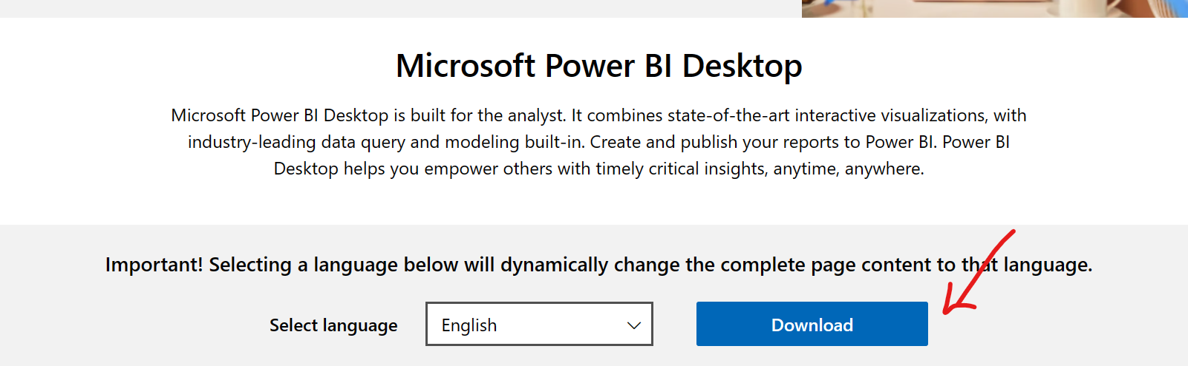
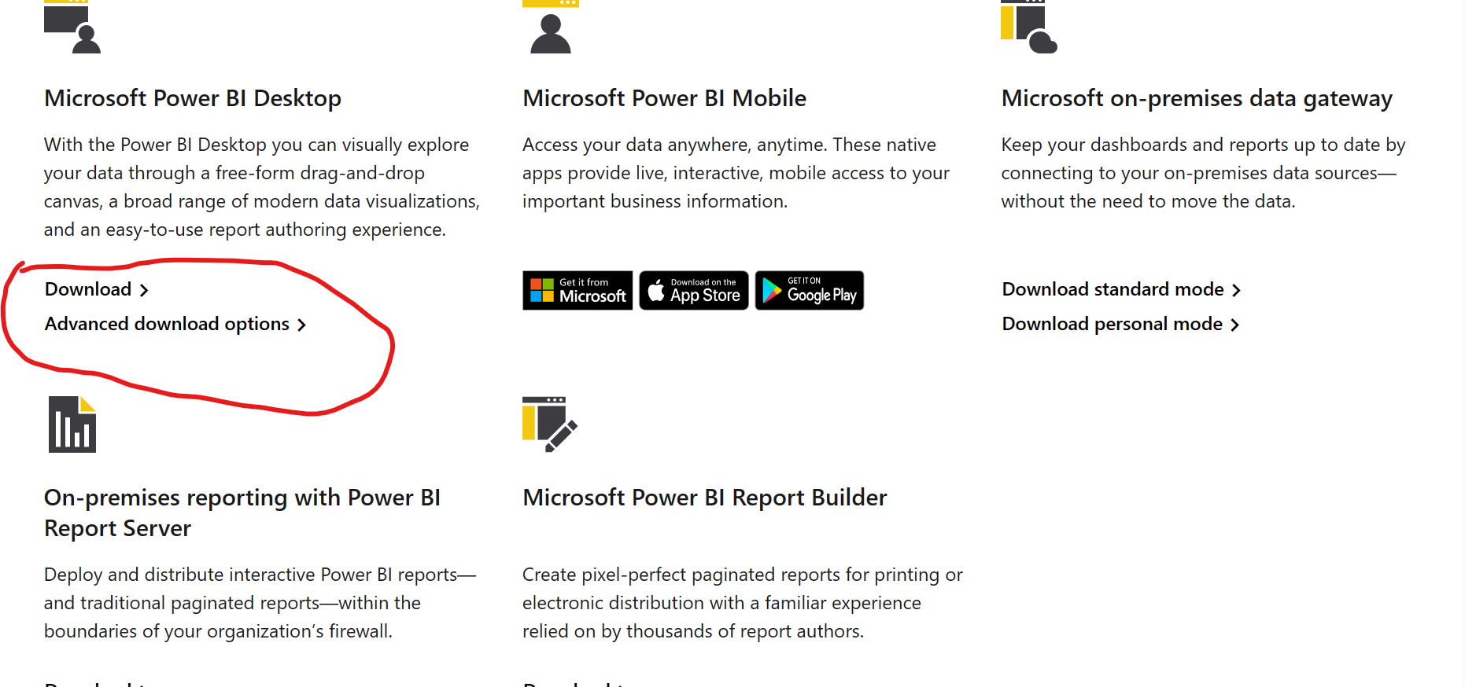
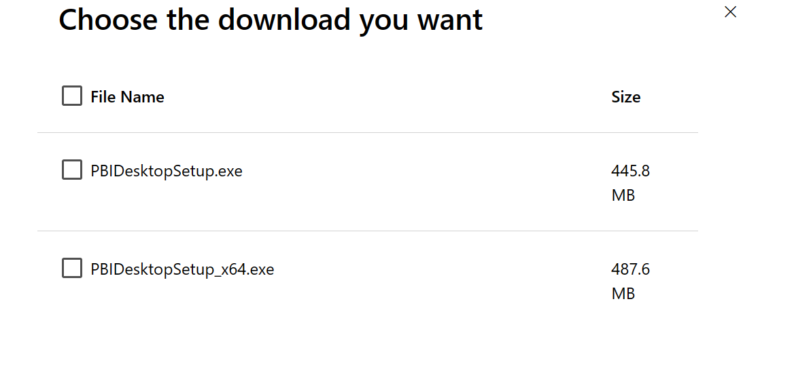
PBI Installation steps :
Downloads | Microsoft Power BI Step 2 & Step3
Step 1 :

Slide 4
PBI -Introduction
It’s Business Intelligence Tool
It’s analyze data, clean data and convert into visual format
Create reports and dashboards
Power BI :
PBI Desktop PBI Services
App.PowerBI.com
Power View
Power Query
Power Pivot

